Slide 1
Clustering Methods
Ali Madani
Farnoosh Khodakarami

Slide 2
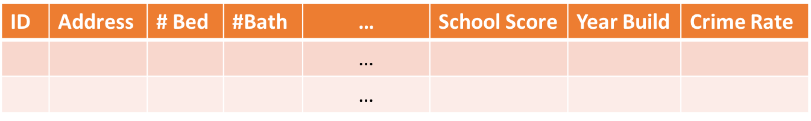
DataSets
Features(Attribute/variable)
Data records (samples)
# Features = Dimension of dataset
Notes:
Data Records related to Data Objects / Data points

Slide 3
Unsupervised versus supervised learning
Supervised learning
Trying to predict label or value of data points
Unsupervised learning
Unlabeled input data
Notes:
Data Records related to Data Objects / Data points

Slide 4
Why do we use clustering?
Group data points based on their similarities using the given features
Identify similar data points (within the same group)
Identify dissimilar data points (within different groups)
Some methods also identifies outliers and points that cannot be assigned to any cluster
Investigating differences between the groups
Survival of breast cancer patients
Notes:
Data Records related to Data Objects / Data points

Slide 5
Categories of clustering methods that we focus on
Clustering methods
Hierarchical
Partitional
Notes:
Data Records related to Data Objects / Data points

Slide 6
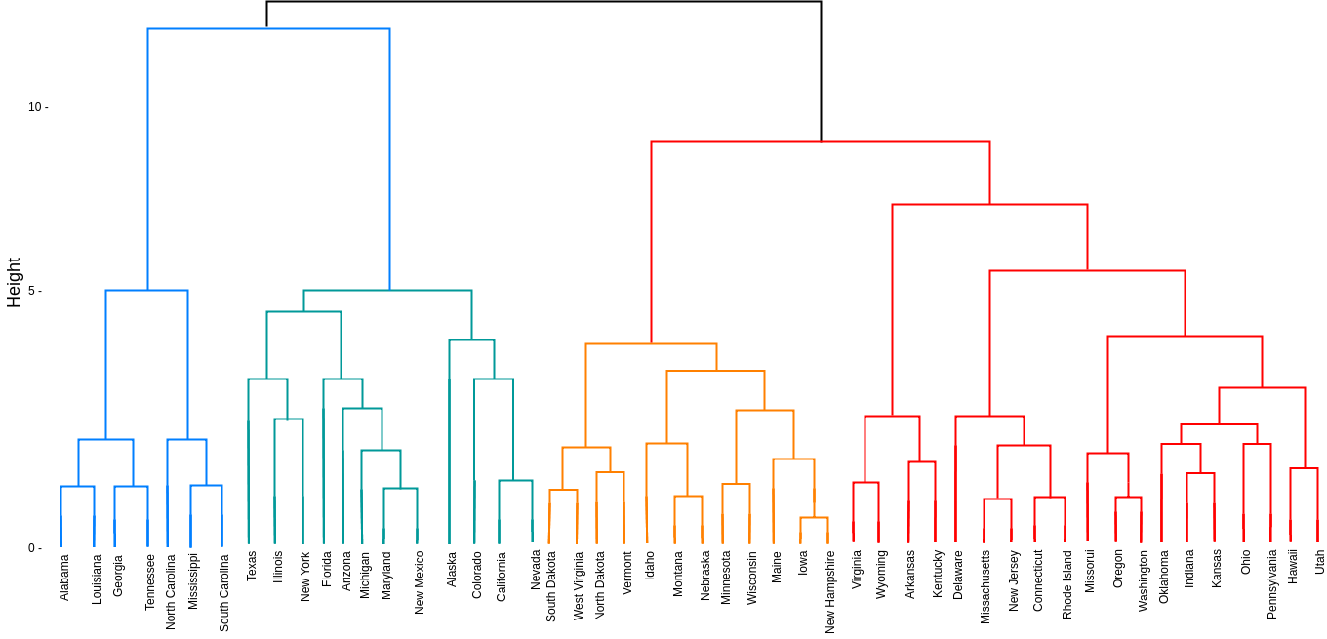
Agglomerative hierarchical clustering
Dendrogram
https://online.visual-paradigm.com/diagrams/templates/dendrogram/cluster-dendrogram/
Notes:
Data Records related to Data Objects / Data points

Slide 7
Steps of agglomerative hierarchical clustering
Computing dissimilarity or similarity between every pair of data points
Using linkage function to group objects into hierarchical cluster tree
linkage function determines the distance between sets of data points as a function of the pairwise distances between data points in the groups.
Deciding where to cut the hierarchical tree into clusters.
Notes:
Data Records related to Data Objects / Data points

Slide 8
Common distance measures used in clustering
Euclidean distance
Manhattan distance
Minkowski distance
Chebychev distance
Cosine similarity
Hamming distance
Binary distance
Jaccard index
Hamming distance
Notes:
Data Records related to Data Objects / Data points

Slide 9
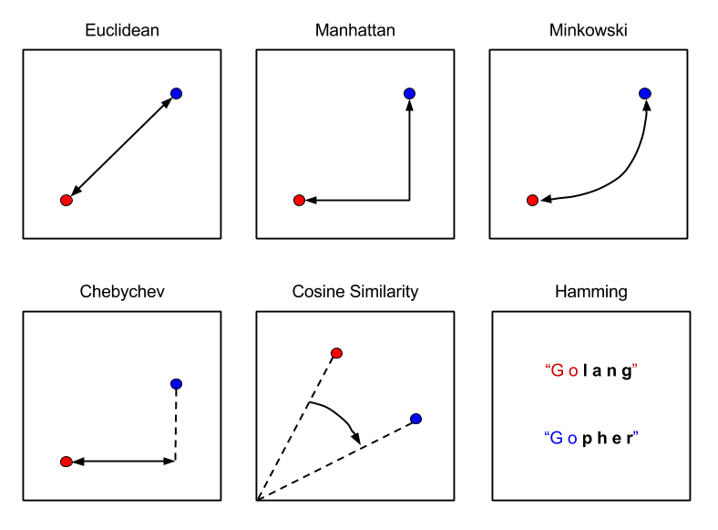

Euclidean distance
Euclidean
https://subscription.packtpub.com/
Notes:
Data Records related to Data Objects / Data points

Slide 10

Manhattan distance
Manhattan
https://subscription.packtpub.com/
Notes:
Data Records related to Data Objects / Data points

Slide 11
Minkowski distance
Minkowski
https://subscription.packtpub.com/
Notes:
Data Records related to Data Objects / Data points

Slide 12
Chebychev distance
Chebychev
https://subscription.packtpub.com/
Notes:
Data Records related to Data Objects / Data points

Slide 13
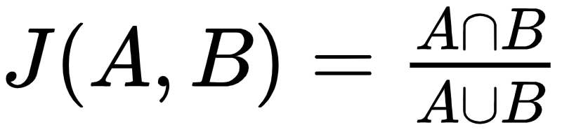
Jaccard index
Jaccard
https://subscription.packtpub.com/
Notes:
Data Records related to Data Objects / Data points

Slide 14
Hamming distance
d=number of bits that they are different
Hamming
https://subscription.packtpub.com/
Notes:
Data Records related to Data Objects / Data points

Slide 15
Different distance measures
Euclidean
Manhattan
Minkowski
Chebychev
Jaccard
Hamming
https://subscription.packtpub.com/
Notes:
Data Records related to Data Objects / Data points

Slide 16
Some of widely-used linkage functions
Single
Complete
Average
Median
Centroid
Notes:
Data Records related to Data Objects / Data points

Slide 17
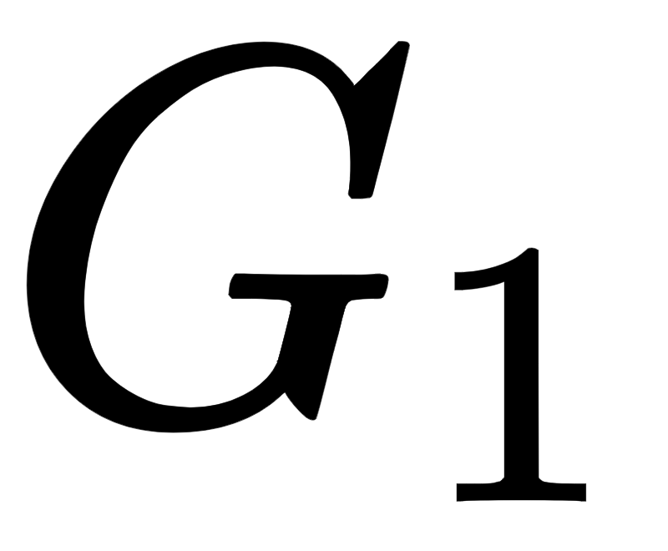
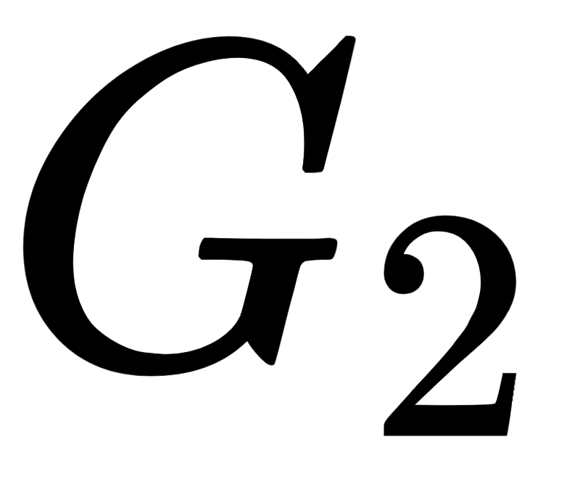
Some of widely-used linkage functions
Single
Complete
Average
Median
Centroid
Notes:
Data Records related to Data Objects / Data points

Slide 18
Some of widely-used linkage functions
Single
Complete
Average
Median
Centroid
Notes:
Data Records related to Data Objects / Data points

Slide 19
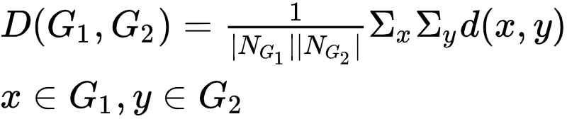
Some of widely-used linkage functions
Single
Complete
Average
Median
Centroid
Notes:
Data Records related to Data Objects / Data points

Slide 20
Some of widely-used linkage functions
Single
Complete
Average
Median
Centroid
Weighted center of mass distance (WPGMC) Note. appropriate for Euclidean distances only
Notes:
Data Records related to Data Objects / Data points

Slide 21

Some of widely-used linkage functions
Single
Complete
Average
Median
Centroid
Note. appropriate for Euclidean distances only
Notes:
Data Records related to Data Objects / Data points

Slide 22
Let’s see how agglomerative hierarchical clustering works
Dendrogram
a
b
e
d
c
Height
Data points should be rearranged for building the dendrogram
a
e
c
b
d
Notes:
Data Records related to Data Objects / Data points

Slide 23
Let’s see how agglomerative hierarchical clustering works
Dendrogram
a
b
e
d
c
Height
Data points should be rearranged for building the dendrogram
a
e
c
b
d
Notes:
Data Records related to Data Objects / Data points

Slide 24
Let’s see how agglomerative hierarchical clustering works
Dendrogram
a
b
e
d
c
Height
a
e
c
b
d
Notes:
Data Records related to Data Objects / Data points

Slide 25
Let’s see how agglomerative hierarchical clustering works
Dendrogram
a
b
e
d
c
Height
a
e
c
b
d
Notes:
Data Records related to Data Objects / Data points

Slide 26
Hierarchical versus partitional clustering
Partitional clustering: division of the set of data points into clusters
each data object belongs to one subset
Hierarchical clustering is a set of nested clusters
organized as a tree
Notes:
Data Records related to Data Objects / Data points

Slide 27
K-means clustering
Steps of k-means clustering
Choosing k
Notes:
Data Records related to Data Objects / Data points

Slide 28
K-means clustering
Steps of k-means clustering
Choosing k
Randomly selecting k data points (as initial centers)
Final result depend on these points
Because k-means converges to one of many possible local minima
Notes:
Data Records related to Data Objects / Data points

Slide 29
K-means clustering
Steps of k-means clustering
Choosing k
Randomly selecting k data points (as initial centers)
Calculating distance of every data point to the chosen centers in step (2)
Notes:
Data Records related to Data Objects / Data points

Slide 30
K-means clustering
Steps of k-means clustering
Choosing k
Randomly selecting k data points (as initial centers)
Calculating distance of every data point to the chosen centers in step (2)
Assign each data point to the nearest center
Notes:
Data Records related to Data Objects / Data points

Slide 31
K-means clustering
Steps of k-means clustering
Choosing k
Randomly selecting k data points (as initial centers)
Calculating distance of every data point to the chosen centers in step (2)
Assign each data point to the nearest center
Calculate new center of each cluster
Notes:
Data Records related to Data Objects / Data points

Slide 32
K-means clustering
Steps of k-means clustering
Choosing k
Randomly selecting k data points (as initial centers)
Calculating distance of every data point to the chosen centers in step (2)
Assign each data point to the nearest center
Calculate new center of each cluster
Repeat steps (3) to (5) until convergence
No point in changing cluster membership
Notes:
Data Records related to Data Objects / Data points

Slide 33
Implementing k-means manually (simple example)
Choosing k (good guess k=3)
Notes:
Data Records related to Data Objects / Data points

Slide 34
Implementing k-means manually (simple example)
Choosing k (good guess k=3)
Randomly selecting 3 data points (as initial centers)
Notes:
Data Records related to Data Objects / Data points

Slide 35
Implementing k-means manually (simple example)
Choosing k (good guess k=3)
Randomly selecting 3 data points (as initial centers)
Calculating distance of every data point to the chosen centers in step (2)
Notes:
Data Records related to Data Objects / Data points

Slide 36
Implementing k-means manually (simple example)
Choosing k (good guess k=3)
Randomly selecting 3 data points (as initial centers)
Calculating distance of every data point to the chosen centers in step (2)
Assign each data point to the nearest center
Notes:
Data Records related to Data Objects / Data points

Slide 37
Implementing k-means manually (simple example)
Choosing k (good guess k=3)
Randomly selecting 3 data points (as initial centers)
Calculating distance of every data point to the chosen centers in step (2)
Assign each data point to the nearest center
Calculate new center of each cluster
Notes:
Data Records related to Data Objects / Data points

Slide 38
Implementing k-means manually (simple example)
Choosing k (good guess k=3)
Randomly selecting 3 data points (as initial centers)
Calculating distance of every data point to the chosen centers in step (2)
Assign each data point to the nearest center
Calculate new center of each cluster
No need for repetition
Good choice of initial centers
Fast convergence
Notes:
Data Records related to Data Objects / Data points

Slide 39
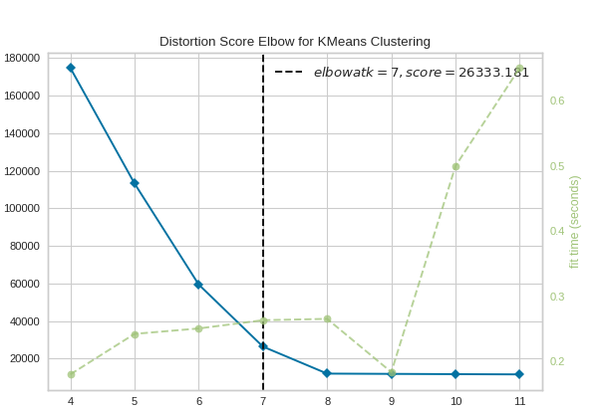
Elbow method for selecting optimal K
Distortion is the sum of squared distances from each point to its assigned center
Distortion
k
https://www.scikit-yb.org/en/latest/api/cluster/elbow.html
Notes:
Data Records related to Data Objects / Data points

Slide 40
Hierarchical k-means (divisive hierarchical clustering)
Start with all the data points
Implement k-means (k=2) in an iterative manner
Until reaching singletons (data points)
Notes:
Data Records related to Data Objects / Data points

Slide 41
Hierarchical k-means (divisive hierarchical clustering)
Issue with this process:
Some real clusters could be dismissed because of iterative k-means
Notes:
Data Records related to Data Objects / Data points

Slide 42
Hierarchical k-means (divisive hierarchical clustering)
Issue with this process:
Some real clusters could be dismissed because of iterative k-means
Notes:
Data Records related to Data Objects / Data points

Slide 43
Hierarchical k-means (divisive hierarchical clustering)
Issue with this process:
Some real clusters could be dismissed because of iterative k-means
We like these to be one cluster
Notes:
Data Records related to Data Objects / Data points

Slide 44
Affinity propagation
Number of clusters (k) does not need to be determined
Notes:
Data Records related to Data Objects / Data points

Slide 45
Affinity propagation
Number of clusters (k) does not need to be determined
Using similarity matrix
Need pairwise similarity between data points
Similarity between data points i and j: negative euclidean distance between data points i and j
Notes:
Data Records related to Data Objects / Data points

Slide 46
Affinity propagation
Number of clusters (k) does not need to be determined
Using similarity matrix
Need pairwise similarity between data points
Similarity between data points i and j: negative euclidean distance between data points i and j
Determines clusters and representative data points for the clusters (exemplars)
Notes:
Data Records related to Data Objects / Data points

Slide 47
Affinity propagation
Number of clusters (k) does not need to be determined
Using similarity matrix
Need pairwise similarity between data points
Similarity between data points i and j: negative euclidean distance between data points i and j
Determines clusters and representative data points for the clusters (exemplars)
Iterative massage passing
Data points compete to become exemplars
Exemplars are real data points not centers as in k-means
Notes:
Data Records related to Data Objects / Data points

Slide 48
Affinity propagation
Number of clusters (k) does not need to be determined
Using similarity matrix
Need pairwise similarity between data points
Similarity between data points i and j: negative euclidean distance between data points i and j
Determines clusters and representative data points for the clusters (exemplars)
Iterative massage passing
Data points compete to become exemplars
Exemplars are real data points not centers as in k-means
Initialization independent
Notes:
Data Records related to Data Objects / Data points

Slide 49
Message matrices
Responsibility matrix: R(i,k)
Responsibility massage from i to k
Accumulated evidence for how well-suited k is to serve s the exemplar for i
Notes:
Data Records related to Data Objects / Data points

Slide 50
Message matrices
Responsibility matrix: R(i,k)
Responsibility massage from i to k
Accumulated evidence for how well-suited k is to serve as the exemplar for i
Availability matrix: A(i,k)
Availability massage from k to i
Accumulated evidence for how appropriate it is for i to choose k
Notes:
Data Records related to Data Objects / Data points

Slide 51
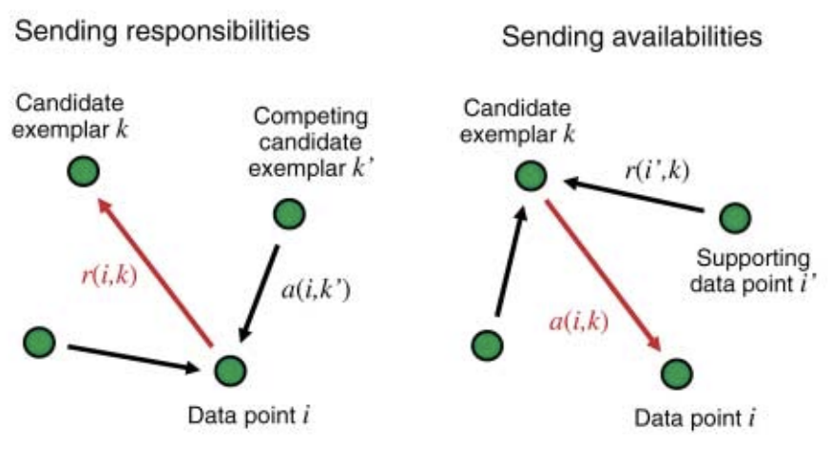
Sending responsibility and availability
Frey, Brendan J., and Delbert Dueck. "Clustering by passing messages between data points." science 315.5814 (2007): 972-976.
Notes:
Data Records related to Data Objects / Data points

Slide 52
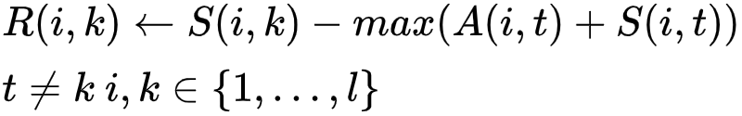
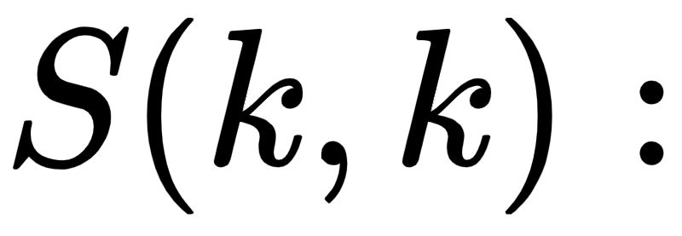
Update rules
1
Called input preferences
Individual tendencies of samples to become exemplars
Important to determine number of clusters
Higher values results in more clusters
Notes:
Data Records related to Data Objects / Data points

Slide 53
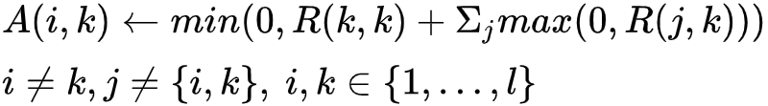
Update rules
1
2
Notes:
Data Records related to Data Objects / Data points

Slide 54
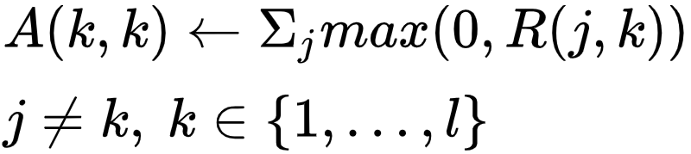
Update rules
1
2
3
Notes:
Data Records related to Data Objects / Data points

Slide 55
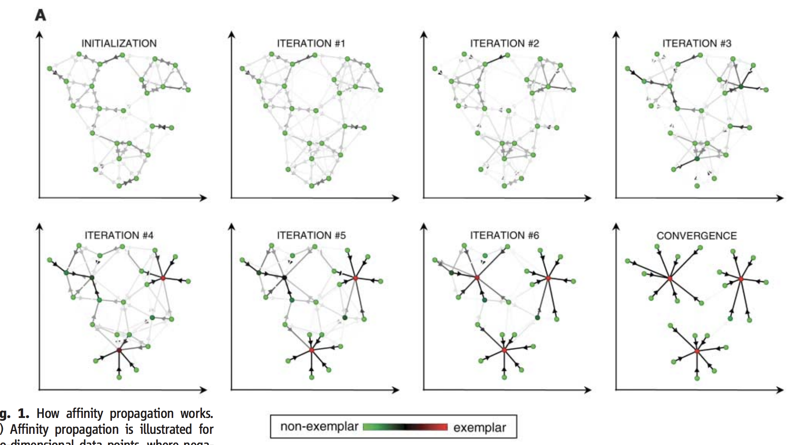
Iterations of affinity propagation for 2 dimensional data points
Frey, Brendan J., and Delbert Dueck. "Clustering by passing messages between data points." science 315.5814 (2007): 972-976.
Notes:
Data Records related to Data Objects / Data points

Slide 56
DBSCAN (Density-Based Spatial Clustering of Applications with Noise)
Let’s look at clusters from another point of view:
Clusters is a maximal set of density-connected points
Ester, Martin, et al. "A density-based algorithm for discovering clusters in large spatial databases with noise." Kdd. Vol. 96. No. 34. 1996.
Notes:
Data Records related to Data Objects / Data points

Slide 57
DBSCAN (Density-Based Spatial Clustering of Applications with Noise)
Let’s look at clusters from another point of view:
Clusters is a maximal set of density-connected points
Two main parameters:
Epsilon (Eps): Maximum radius of neighbourhood
Minimum number of points (MinPts): Minimum number of points in the Eps-neighbourhood of a data point
Ester, Martin, et al. "A density-based algorithm for discovering clusters in large spatial databases with noise." Kdd. Vol. 96. No. 34. 1996.
Notes:
Data Records related to Data Objects / Data points

Slide 58
DBSCAN (Density-Based Spatial Clustering of Applications with Noise)
Two main parameters:
Epsilon (Eps): Maximum radius of neighbourhood
Minimum number of points (MinPts): Minimum number of points in the Eps-neighbourhood of a data point
dist<Eps => this point is in the neighbourhood of data point shown in red
Notes:
Data Records related to Data Objects / Data points

Slide 59
DBSCAN (Density-Based Spatial Clustering of Applications with Noise)
Two main parameters:
Epsilon (Eps): Maximum radius of neighbourhood
Minimum number of points (MinPts): Minimum number of points in the Eps-neighbourhood of a data point
Then that data point will be called a core point
Different types of data points:
Core
Border: within epsilon distance does not meet MinPts criteria
But there is at least 1 core point within the epsilon distance
Noise (Outlier): Not assigned to any clusters
Notes:
Data Records related to Data Objects / Data points

Slide 60
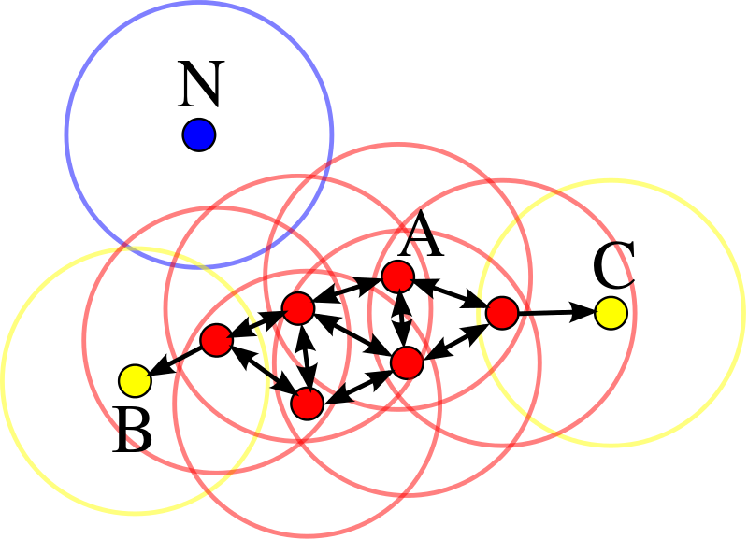
Visualizing different types of data points in DBSCAN
A: Core
B and C: Border
N: outlier
https://en.wikipedia.org/wiki/DBSCAN
Notes:
Data Records related to Data Objects / Data points

Slide 61
Some disadvantages of DBSCAN
May not work well with clusters of similar densities
But great for separating clusters of low and high densities
May not be great with very high dimensional data
Notes:
Data Records related to Data Objects / Data points

Slide 62
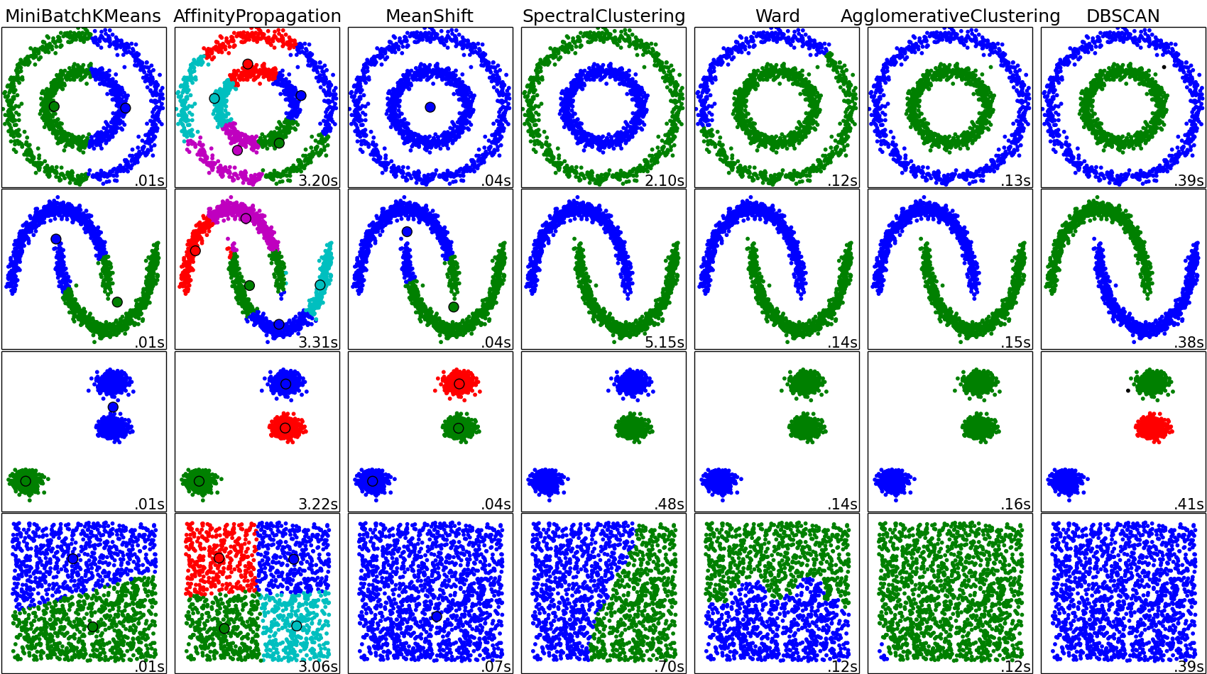
Comparison of clustering methods
Affinity propagation
k-means
Agglomerative
DBscan
https://scikit-learn.org/0.15/auto_examples/cluster/
Notes:
Data Records related to Data Objects / Data points

Slide 63
Comparison of clustering methods
Affinity propagation
k-means
Agglomerative
DBscan
https://scikit-learn.org/0.15/auto_examples/cluster/
Notes:
Data Records related to Data Objects / Data points

